Slide 1
OTHER CONSTRUCTION PRACTICES
B.Tech 2nd Year (IV Semester)
By
Dr. G Santosh Kumar

Slide 2
CONTENTS
DAMP PROOFING AND WATER PROOFING
MATERIALS USED
SPECIFICATIONS OF DAMP PROOF COURSE IN WALL
BASIC PRINCIPLES OF WATER PROOFING OF BASEMENT
PLASTERING
POINTING
WHITE WASHING
DISTEMPERING AND PAINTING
FORMWORK AND SCAFFOLDING
FALSE CEILING
FIRE RESISTING MATERIALS

Slide 3
DAMP PROOFING AND WATER PROOFING
DAMPNESS
Dampness is the presence of hydroscopic or gravitational moisture.
Dampness gives rise to unhygienic conditions apart from reduction in strength of structural components of the building.
In order to prevent the entry of damp into a building, the courses, known as damp proofing courses are provided at various levels of the building.
WATERPROOFING
the treatment given to the roofs of a building for the same purpose is known as water proofing.

Slide 4
VARIOUS CAUSES OF DAMPNESS IN BUILDING
Moisture rising up the walls from ground.
Rain travel from wall tops.
Rain beating against external walls
Condensation
Miscellaneous causes.

Slide 5
EFFECTS OF DAMPNESS
Dampness gives rise to breeding of mosquitoes.
Travel of moisture through walls and ceilings may cause unsighty patches.
Moisture travel may cause softening and crumbling of plaster.
The wall decoration (painting, etc.) will be damaged.

Slide 6
EFFECTS OF DAMPNESS
The flooring gets loosened because of reduction in adhesion when moisture enters through the floor.
Electrical fittings gets deteriorated, giving rise to leakage of electricity and danger of short circuiting.
Moisture causes rusting and corrosion of metal fittings attached to walls, floors and ceiling.

Slide 7
MATERIALS USED FOR DAMP PROOFING
Materials should have following characteristics
The material should be perfectly impervious .
The material should be durable.
The material should be strong.
Material should be flexible.
Material should not be costly.
The material should remain steady in its position when applied once.

Slide 8
MATERIALS
Hot bitumen
Mastic asphalt
Bituminous or asphaltic felts
Metal sheets
Combination of sheets and bituminous felts.
Bricks
Stones
Mortar
Cement concrete
Plastic sheets

Slide 9
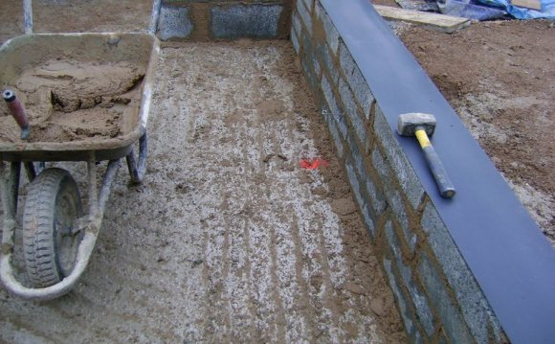
HOT BITUMEN
This is highly flexible material, which can be applied with a minimum thickness of 3mm.
It is placed on the bedding of concrete or mortar while it is in hot condition.

Slide 10
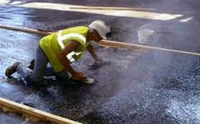
MASTIC ASPHALT
Semi rigid material obtained by heating asphalt with sand and mineral fillers. It is laid on mortar or concrete bed.
However, it should be laid very carefully by experienced persons.

Slide 11
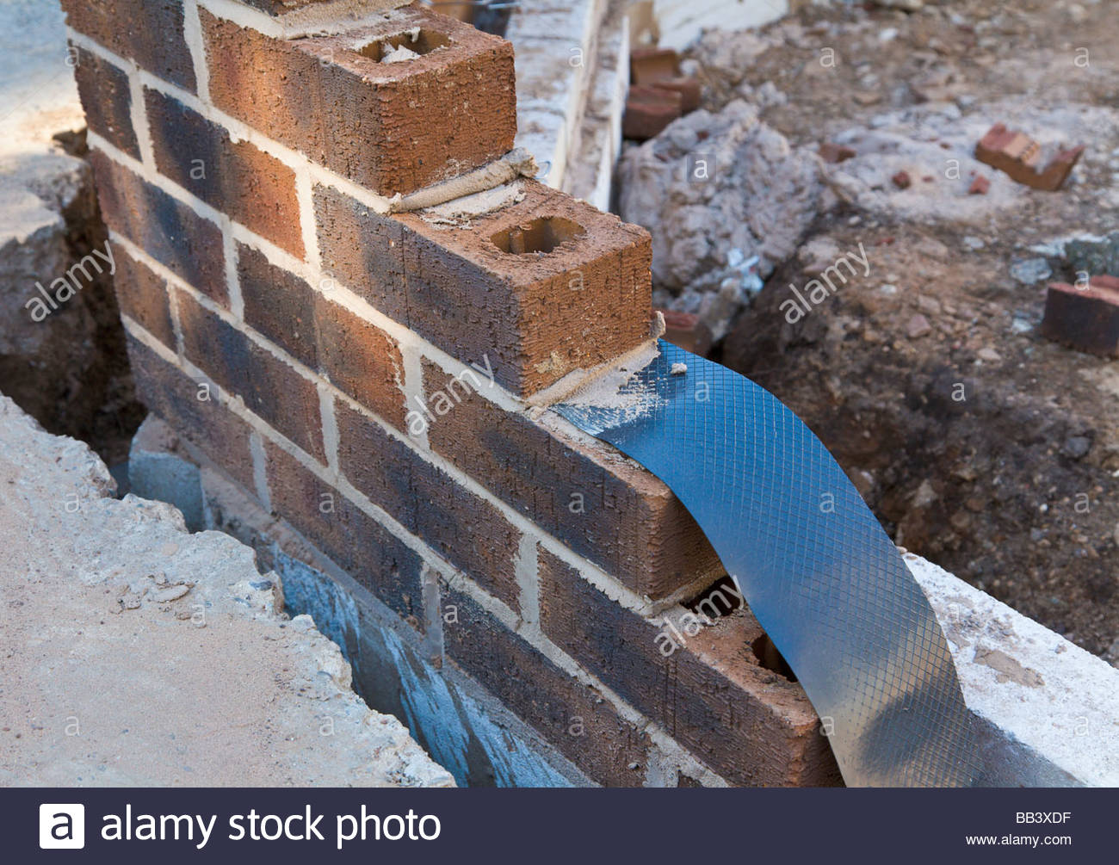
METAL SHEETS
Sheets of lead, copper and aluminium may be used as membrane in damp proofing. Lead is the most ideally suited material.

Slide 12
Combination of sheets and bituminous felts
Lead foil sandwiched between asphaltic or bitumen felts can be effectively used as D.P.C.
The combination known as lead core possesses characteristics of easy laying, durability, efficiency, economy and resistance to cracking.

Slide 13
BRICKS
Special bricks, having water absorption not less than 4.5% of their weight, may be used as D.P.C in locations where damp is not excessive.
These bricks are laid in two to four courses in cement mortar. The joints of bricks are kept open.

Slide 14
STONES
Dense and sound stones, such as granite, trap, slates etc. are laid in cement mortar (1:3) in two courses to form effective D.P.C.
The stones should extend to the fill width of the wall.

Slide 15
MORTAR
Cement mortar (1:3) is used as bedding layer for housing other D.P.C material.
A small quantity of lime may be added to increase workability of the mortar.
In water used for mixing, 75g of soft soap is dissolved per litre of water.

Slide 16
CEMENT CONCRETE
Cement concrete of 1:2:4 mix or 1:1.5:3 mix is generally provided at plinth level to work as D.P.C.
The thickness may vary from 4 cm to 15cm.
Such a layer can effectively check the water rise due to capillary action.
Where dampness is more, two coats of hot bitumen paint may be applied to it.

Slide 17
PLASTIC SHEETS
This is made of black polythene, 0.5 to 1 mm thick in the usual walling width and roll length of 30 m.
C.B.R.I., Roorkee has recently suggested a new D.P.C which comprises a 400 gauge thick alkathene laid over 12 mm thick 1:4 cement mortar.
The treatment is cheaper but is not permanent.

Slide 18
SPECIFICATIONS OF D.P.C IN WALLS

Slide 19
PLASTERING AND POINTING
The exposed surfaces of walls are to be provided with pointing or plastering.
The process of pointing is adopted for stone masonry or brick masonry while plastering is carried out for exposed surfaces of ceilings, walls, columns, etc.

Slide 20
OBJECTIVES OF POINTING AND PLASTERING
To improve the appearance of the structure as a whole and to give smooth surface.
To protect the exposed surfaces from the effects of atmospheric actions.
To rectify the defective workmanship or to conceal inferior materials.

Slide 21
POINTING
It is used to denote the finishing of mortar joints of either stone masonry or brick masonry.
The joints are raked out to a depth of about 20 mm and then, these spaces are filled up by suitable mortar in the desired shape.

Slide 22
MORTAR FOR POINTING
The pointing may be carried out either in lime mortar or in cement mortar.
Lime mortar consists of equal volumes of lime and sand. These two materials are carefully ground in a mortar mill.
The cement mortar consists of equal volumes of cement and sand. The materials are thoroughly mixed in dry condition before water is added to them.

Slide 23
METHOD OF POINTING
The mortar of the masonry joints to be covered by pointing is raked out at least to a depth of 20 mm.
The dust from the masonry joints is removed by the brushes.
The surface is then washed with clean water and it is kept wet for a few hours.
The mortar is then carefully placed in desired shape in these prepared joints.
The finished joints is well watered for a period of at least 3 days, if lime mortar is used and 10 days, if cement mortar is used.

Slide 24
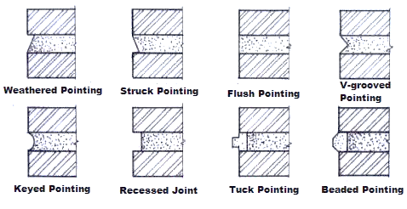
TYPES OF POINTING

Slide 25
PLASTERING
The term plastering used to describe the thin plastic covering that is applied on the surfaces of walls and ceilings.
Plastering removes unevenness of the surfaces and sometimes the plastering is used to develop decorative effects.

Slide 26
REQUIREMENTS OF GOOD PLASTER
It should be adhere to the background and should remain adhered during all variations of the climatic changes.
It should be cheap and economical.
It should be hard and durable.
It should be possible to apply it during all weather conditions.
It should effectively check the entry or penetration of moisture from the surface.
It should possess good workability.

Slide 27
MORTAR FOR PLASTERING
Three types of mortar:
Lime mortar
Cement mortar
Water proof mortar

